Slide 1
SYBSc ENGLISH
Topic 3(Enquiry & Placing Order
4(Complaint /Adjustment /Regret)
BUSINESS LETTERS

Slide 2
What are business letters?
A business letter is a letter from one company to another, or between such organizations and their customers, clients, or other external parties.
The overall style of letter depends on the relationship between the parties concerned.
A business letter includes contact information, a salutation, the body of the letter, a complimentary close, and a signature.

Slide 3
The Purpose of a Business Letter
Information mail
Enquiry
Reply to enquiry
Arrangement
Placing an order/ cancelling/ modifying an order
Complaining about products/ delayed delivery/ service

Slide 4
Parts of a business letter
Experts generally agree that there are seven basic parts in a business letter:
Sender's address. Optimally, you want to have printed company letterhead. ...
Date. Whoever receives the letter needs to know when the letter was written. ...
Recipient's address. ...
Salutation. ...
Body. ...
Closing/signature. ...
Enclosures/ Attachments

Slide 5
Your Contact Information
Your Name
Your Job Title
Your Company
Your Address
City, State PIN Code
Your Phone Number
Your Email Address

Slide 6
Recipient’s Contact Information
Their Name
Their Title
Their Company
The Company’s Address
City, State PIN Code

Slide 7
The Salutation
Use "To Whom It May Concern," if you’re unsure specifically whom you’re addressing.
Use the formal salutation “Dear Mr./Ms./Dr. [Last Name],” if you do not know the recipient.
Use “Dear [First Name],” only if you have an informal relationship with the recipient.

Slide 8
The Body
Use single-spaced lines with an added space between each paragraph, after the salutation, and above the closing.
Left justify your letter (against the left margin).

Slide 9
Closing Salutation
Keep your closing paragraph to two sentences. Simply reiterate your reason for writing and thank the reader for considering your request.
Some good options for your closing include:
Respectfully yours
Yours sincerely
Cordially
Respectfully

Slide 10
If your letter is less formal, consider using:
All the best
Best
Thank you
Regards

Slide 11
What Should You Include in an Email Signature?
At a minimum, an email signature should contain your full name, your email address, and your phone number, so that hiring managers can see, at a glance, how to contact you.
You might also include your current job title, the company you work for, and your full address. Including a link to your LinkedIn profile is a good way to give the hiring manager more information on your skills and abilities.
You can also add a LinkedIn button to your email signature if you prefer. You might also link to your Twitter account if you are using it for job search or other career-related purposes. For applicants in creative fields, such as writers or designers, adding a link to an online portfolio is an excellent idea. Or if you have your own professional website, you can add a link to it.

Slide 12
Examples of Email Signatures
FirstName Last Name
Email Address
Phone
FirstName Last Name
Marketing Director, ABC Company
Street
City, State Zip Code
Email Address
Phone
FirstName Last Name
Email Address
Phone
LinkedIn URL
FirstName Last Name
Email Address
Phone
LinkedIn URL
Twitter Account

Slide 13
Format of a formal letter

Slide 14
what is an inquiry email?
Inquiry means an act of asking for information. So, business inquiries email are emails used to ask for information.
It is very simple: you write an e mail to ask people for the information you need.
you use an inquiry email to express your interest in a specific product.
You have seen an advertisement or received a sales call earlier. You want to know more about their services. Hence, you write this inquiry email

Slide 15
5 steps to write an inquiry email:
1. Subject :The subject is one of the first 2 parts that directly show up to the recipient’s sight. So be very specific about writing the subject
2. Opening: There is a surprisingly simple yet very effective flow you can use at the beginning of an inquiry email: Greet – Introduce – Reference.
Greet:
Firstly, greet your recipient using traditional salutations:
– If you don’t know the recipient’s name: write Dear Sir/Dear Madam/Dear Sir or Madam. You can also address the whole company or department: Dear Sales Department.
– If you know the recipient’s name: use Dear + courtesy titles (Mr., Ms., Mrs.) + their last name

Slide 16
Introduce:
Secondly, kindly introduce yourself so your recipient know who they are talking with. This will make it easier for both of you to do business. You should include your name, job title, department as well as your company’s name.
I am [name], [title]/from … department of … company. Our company is a retailer/supplier specialized in

Slide 17
Reference:
Thirdly, tell them where you get their contact. It could be from an advertisement or a sales call. If someone in your network refers to this company, say it as well.
Based on your reference, the recipient can identify which type of partner you are. Consequently, they can deal with your request in the most suitable way.

Slide 18
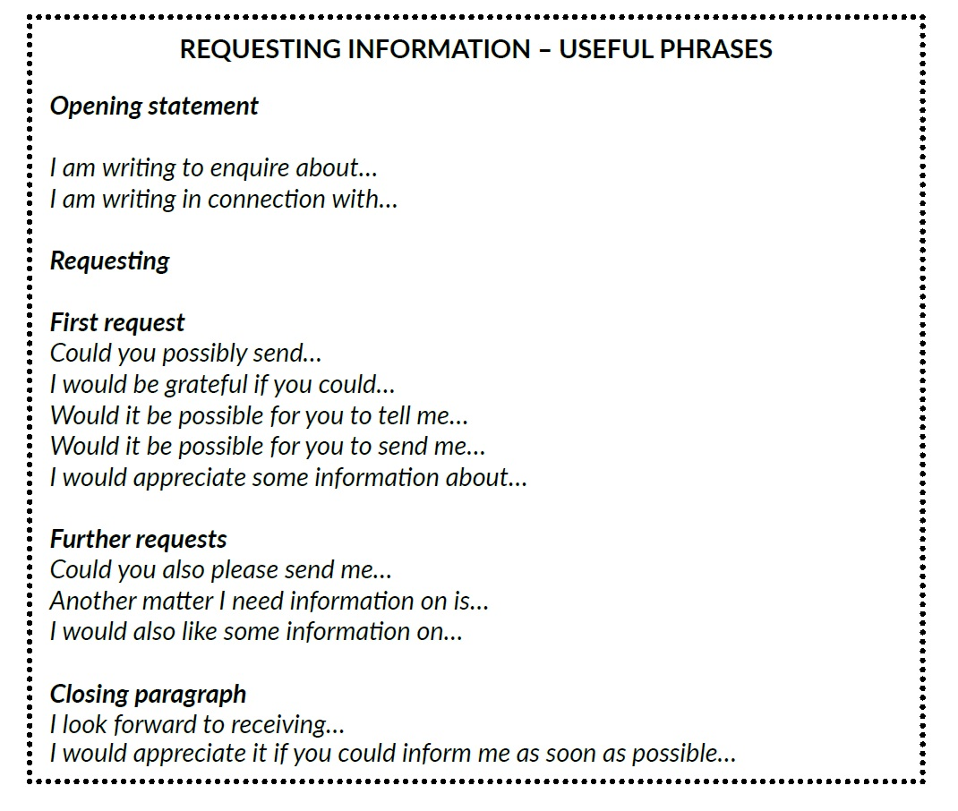

Slide 19
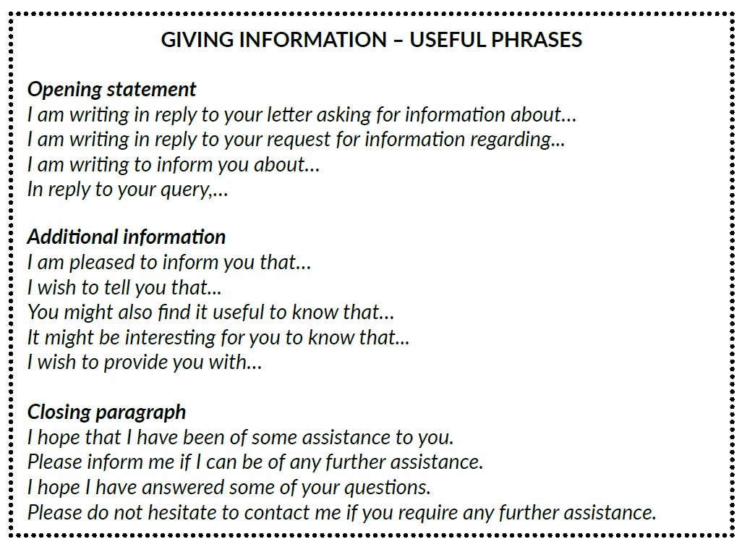

Slide 20
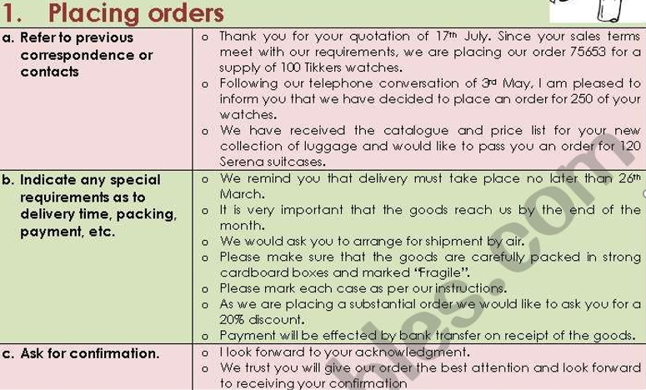

Slide 21
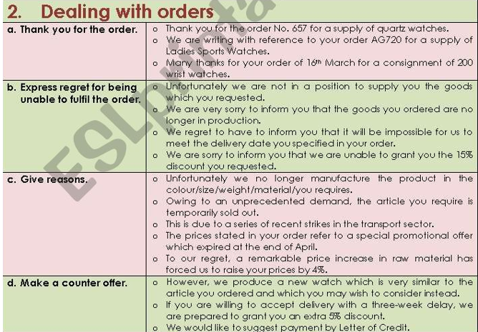

Slide 22
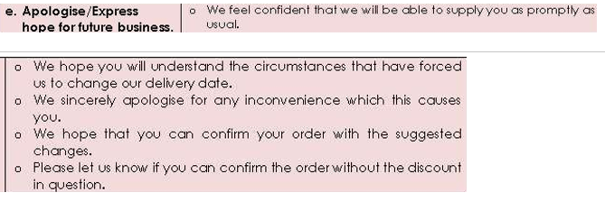

Slide 23
Adjustment letters
Factors to be considered while drafting Adjustment Letter Or, Contents of Adjustment Letter
In drafting adjustment letter, the following points should be kept in mind so that in can convince the affected buyer:
Acknowledging the claim letter: At the begging of the adjustment letter, the seller should acknowledge the claim letter of the customer and thank the customer for pointing out the mistakes.
Regretting for mistakes: Reply letter should regret the mistakes and inconvenience of the seller sincerely. If the seller is definitely at fault, he can apologize by saying,” I am sorry”, “We apologize” etc.
Immediate reply: After receiving a complaint from the buyer, the seller should give its reply immediately. Delay in reply may create further arrogance.

Slide 24
Granting immediate promise: If the customer demand for something specific like a refund or replacement, the seller should grant the promise immediately.
Assuring preventive measures: After receiving the claim from the customers, preventive measures taken by seller should be indicated. Seller must also assure the customer that he will not face any such inconvenience in the future.
Offering further cooperation: In order to promote the goodwill of the company and sustain a relationship with customers, the seller should offer further cooperation and assurance of satisfaction.
Convincing customer: If the claim of the customer is unfair, unreasonable and unjust, the seller should not react violently. Rather, he should convince the buyer to consider the matter from the seller’s angle.

